Slide 1
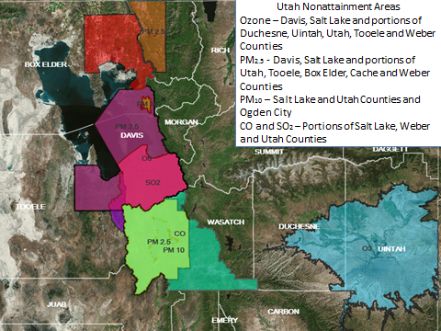
Air Quality Update
Non-attainment
Focused on meeting federal air quality standards through planning, permitting and compliance
Serious State Implementation Plan for Salt Lake Non-attainment area
Clean Data Determinations for Logan, Provo and Salt Lake (pending) Non-attainment areas
Notes:
This first slide comes from DEQ

Slide 3
29 State Senate Districts:
Logan to Provo covers 22 districts: 1-6, 8-12, 14-23, 25.
All 22 of these districts have pollution problems, as do parts of 7, 13, 24, 26, and 27.
What’s left? 28 and 29.
25
17
19
20
18
21
22
23
1
2
5
3
4
12
6
8
10
9
11
14
13
15
16
26
7
27
24
28
29

