Slide 1

Air Quality in Utah
An Overview
Glade Sowards - Senior Policy Analyst
Utah Division of Air Quality

Slide 2
What do we mean when we say “air quality” in Utah?

Slide 3
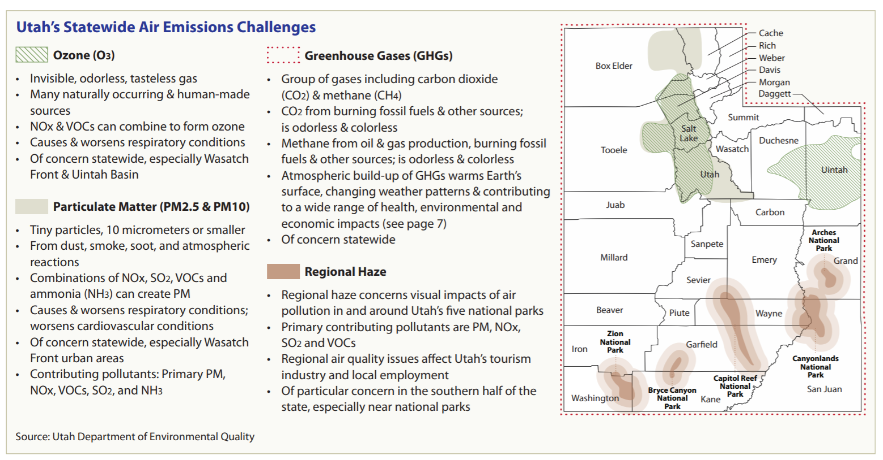

Slide 4
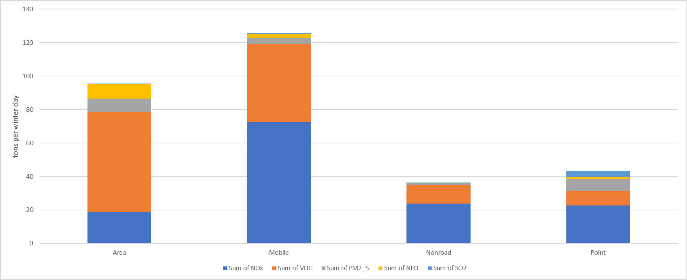
2017 Wasatch Front Winter Day Emissions by Source

Slide 5
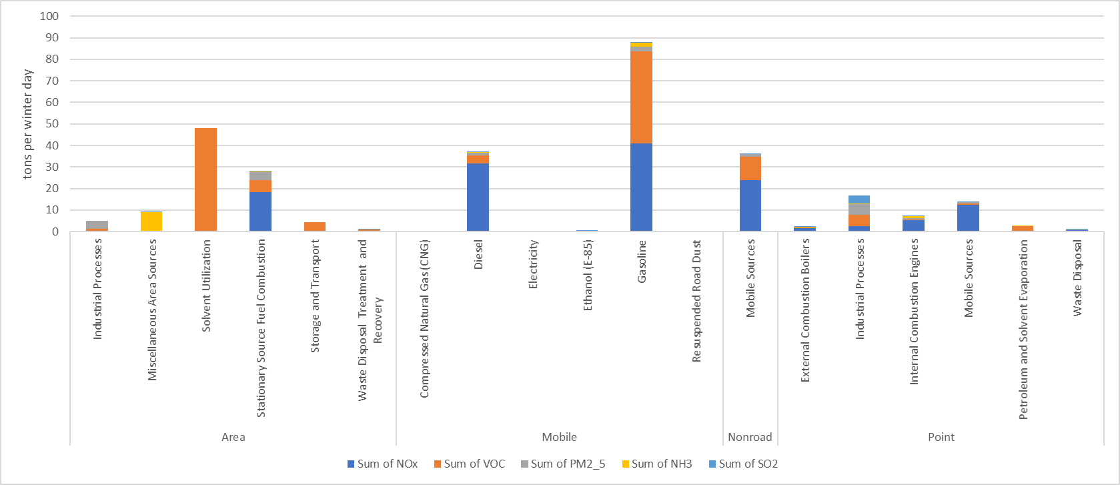
2017 Wasatch Front Winter Day Emissions by Source

Slide 6
Area Sources

Slide 7
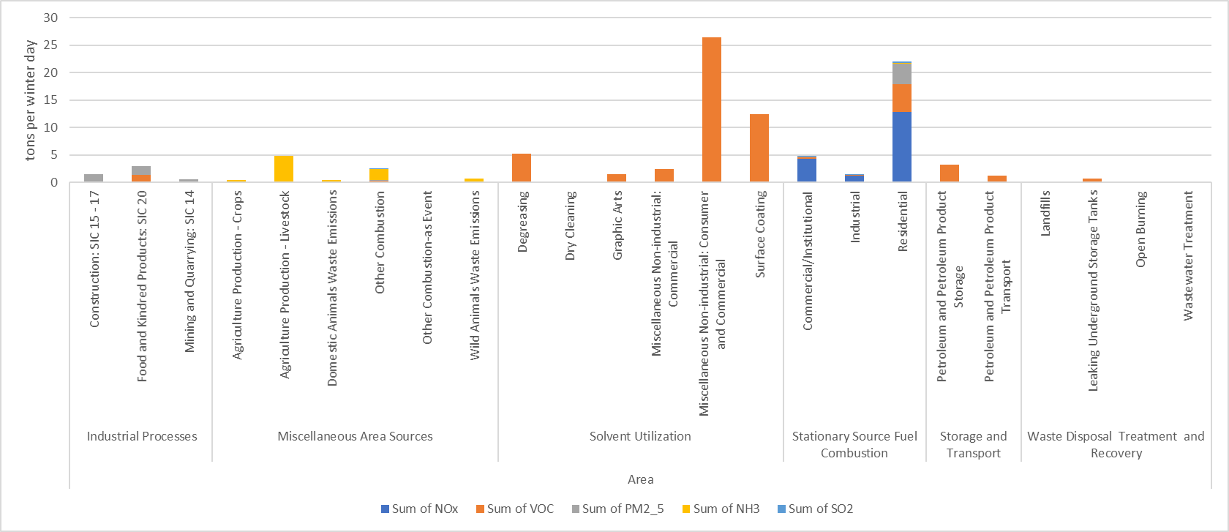
2017 Wasatch Front Winter Day Emissions by Source

Slide 8
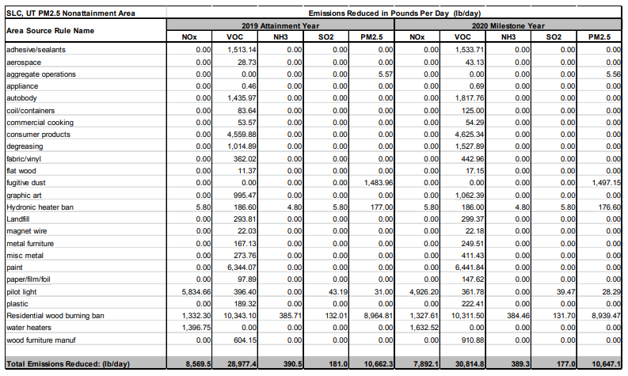
Area Source Rules

Slide 9
On-road Mobile Sources

Slide 10
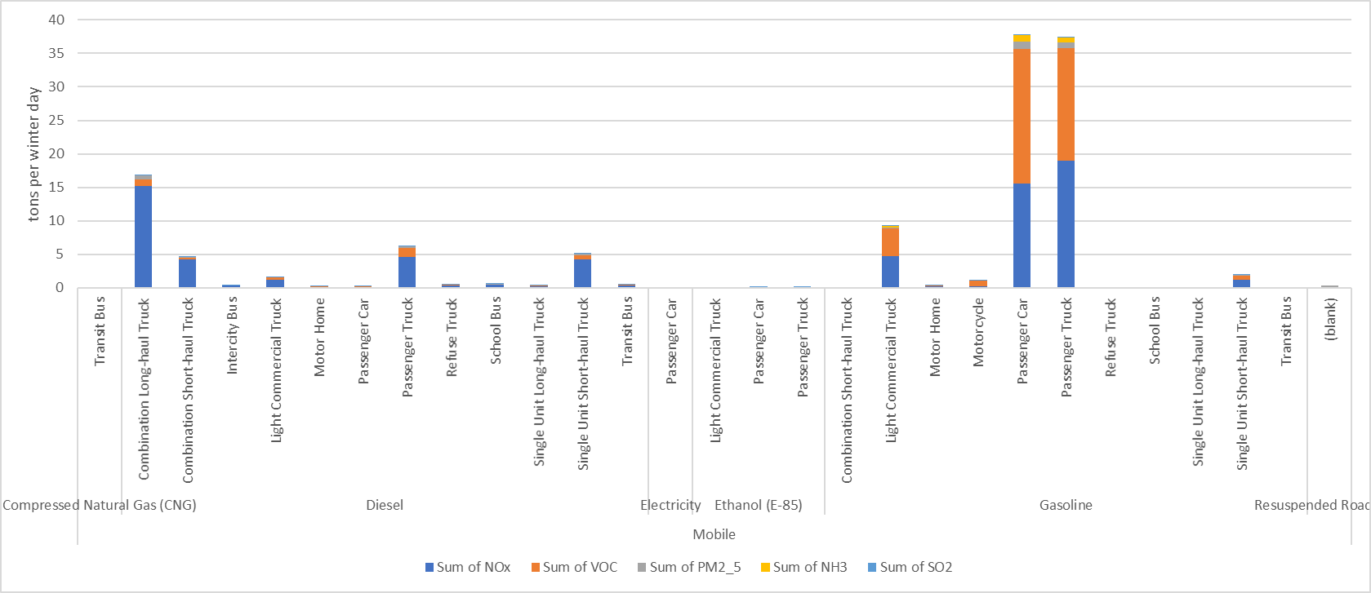
2017 Wasatch Front Winter Day Emissions by Source

Slide 11
Source: EPA for emissions standards; Utah Tax Commission for vehicle registrations (Registrations with an expiration of January 1, 2017 or greater as of February 15, 2017).

Slide 12
Source: EPA MOVES model using data for Salt Lake County.

Slide 13
Source: EPA for emissions standards; Utah Tax Commission for vehicle registrations (Registrations with an expiration of January 1, 2018 or greater as of February 15, 2018).

Slide 14
Source: EPA MOVES model using data for Salt Lake County.

Slide 15
Non-road Mobile Sources

Slide 16
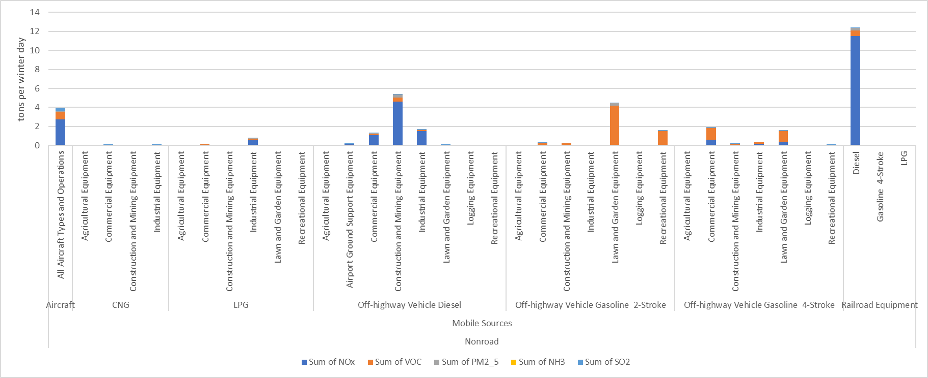
2017 Wasatch Front Winter Day Emissions by Source

Slide 18
EPA Switcher Locomotive Standards

Slide 19
Point Sources

Slide 20
2017 Wasatch Front Winter Day Emissions by Source

Slide 21
2017, 2026, and 2035 Wasatch Front Winter Day Emissions by Source

Slide 22
Statewide Emissions

Slide 25
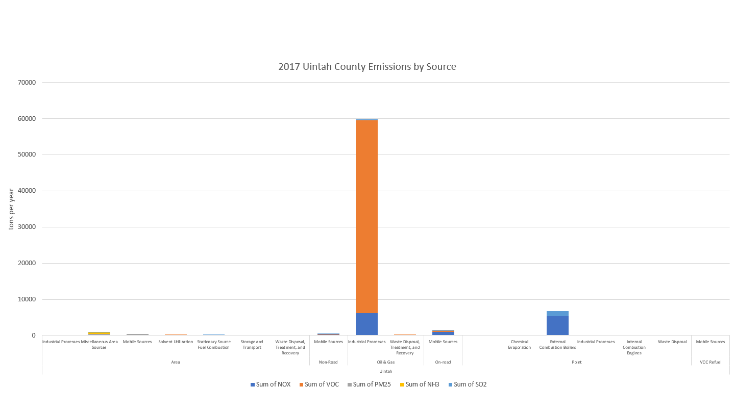

Slide 27
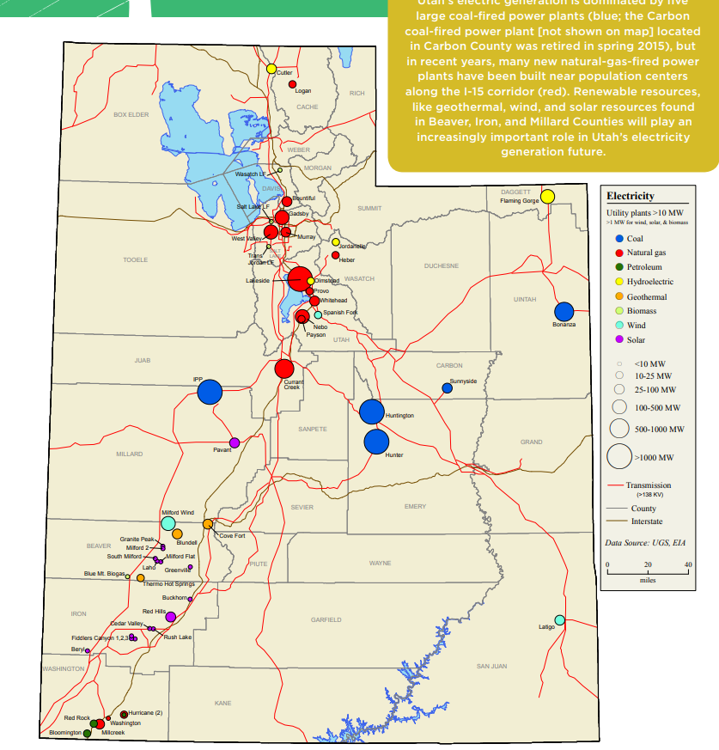
Source: Utah Geological Survey

Slide 28
Comparable 2018 generation
5.1 million MWh
4.9 million MWh

Slide 29
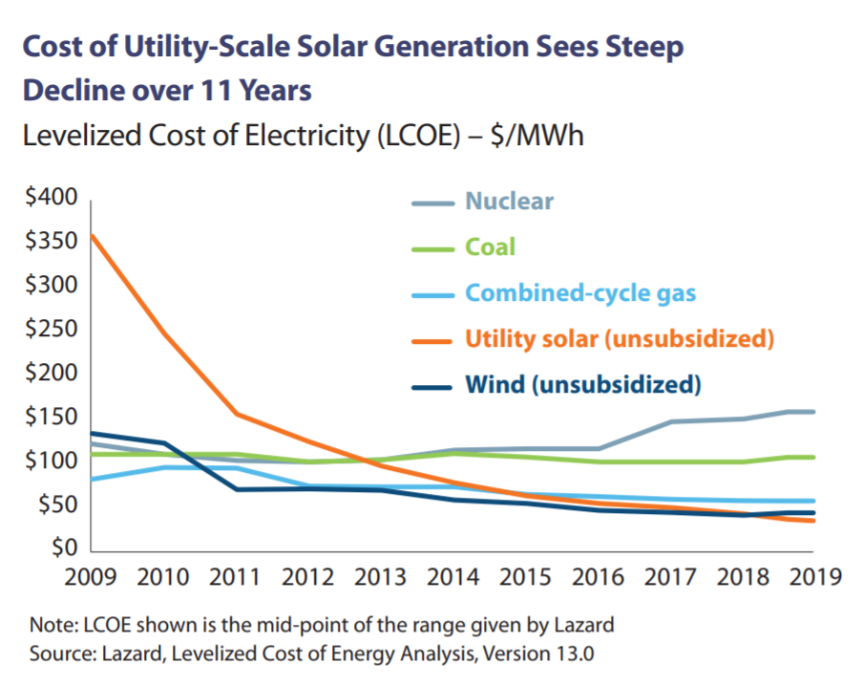

Slide 30
Source: Utah Geological Survey

Slide 31
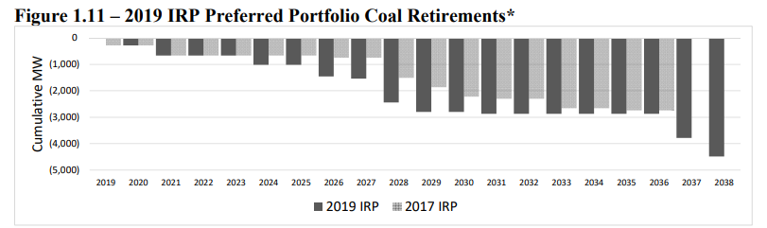
Source: PacifiCorp

Slide 32
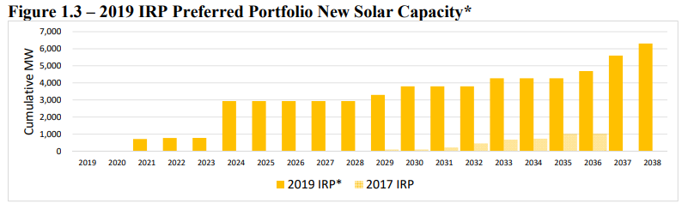
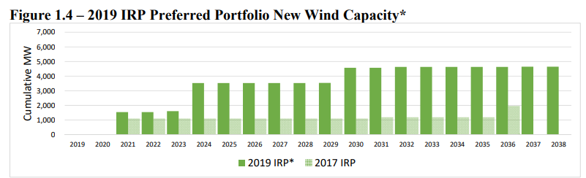
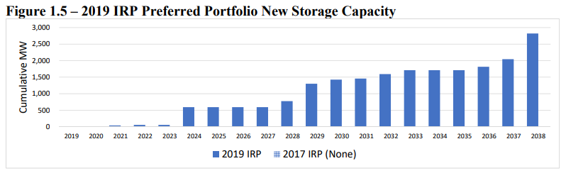
Source: PacifiCorp

Slide 33
Notes:
Assumptions:
Area and onroad follow Wasatch Front 2026-2035 projections through 2050
Nonroad follows Wasatch Front from 2017-2035, then flat through 2050
Point is flat from 2017-2024, then decreases with each power plant closure through 2042
Oil & gas and VOC refueling are flat from 2017-2050
2017-2050 change: 20.5% decrease

Slide 35
Questions?

